Slide 1


Department of Artificial Intelligence and Data Science
Smart Billing Software
SANJAY B (221801045)
SOORYA B (221801051)
THOFIQ GANI M (221801057)

Slide 2
Objectives
The objective of this project is to develop an automated billing system that uses QR codes for quick, secure payments. Customers can pay by scanning a QR code, enhancing convenience and reducing wait times. The system automatically saves purchase details in an Excel file for accurate data management. Supporting multiple payment options, it meets diverse customer needs. Ultimately, this system improves billing accuracy, customer satisfaction, and business efficiency.

Slide 3
Abstract
This project introduces an automated billing system with QR code technology for fast and secure online payments. Customers can pay by scanning a QR code, making transactions quick and convenient. The system automatically records purchase details in an Excel file for accurate data tracking. Supporting multiple payment methods, it meets diverse customer preferences. It also generates insights on sales trends and customer behavior, enabling better business decisions. This solution addresses the limitations of traditional billing, enhancing both customer satisfaction and efficiency. Overall, it provides a modern, streamlined approach to billing.

Slide 4
Introduction and Overview of the Project.
Customer Experience: Enhance payment convenience by allowing customers to pay instantly by scanning a QR code, reducing wait times.
Data Management: Automatically record purchase details and payment methods in an Excel file, ensuring accurate and organized data.
Sales Insights: Provide businesses with valuable insights into sales trends and customer preferences through data analysis.

Slide 5
Existing System
Manual Billing Process: Most businesses currently rely on manual billing methods, which can be time-consuming and prone to errors.
Lack of Real-Time Data: Businesses struggle to access real-time sales data, making it challenging to analyze trends or customer preferences effectively.
Customer Delays: The manual processing of payments can result in longer wait times for customers, impacting their overall experience.

Slide 6
Drawback of Existing System
Time-Consuming: The manual billing process requires significant time and effort, leading to longer customer wait times.
Poor Customer Experience: Lengthy payment processes and limited options can frustrate customers, negatively impacting their overall shopping experience.
Slow Reporting: Generating reports on sales trends and customer behavior is often slow and cumbersome, reducing the ability to make timely business decisions.

Slide 7
Proposed System
The proposed system is an automated billing solution using QR codes for fast, secure payments. Customers can easily pay by scanning a QR code, improving convenience. The system automatically records purchases in Excel for accurate data management. It supports various payment options to meet customer needs. Real-time data insights help businesses make better decisions. This system addresses traditional billing limitations, enhancing customer satisfaction and efficiency.

Slide 8
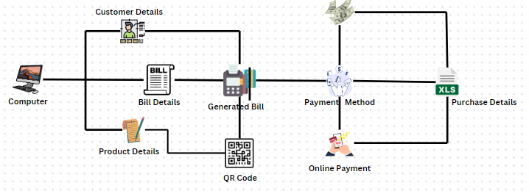
System Architecture

Slide 9
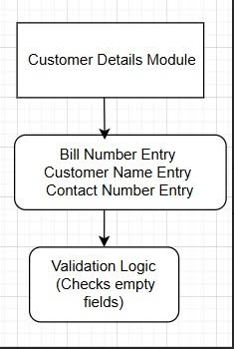
List of modules
Customer Details Module
Inputs: Bill Number, Customer Name, Contact
Number.
Actions: Collects user inputs and validates them.
Output: Customer data is ready for further
use (like saving to Excel).

Slide 10
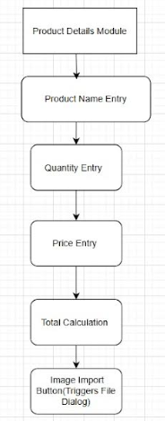
List of modules
Product Details Module
Inputs: Product Name, Quantity, Price.
Actions: Validates inputs, calculates total, and allows image import.
Output: Displays product details and total price.

Slide 11
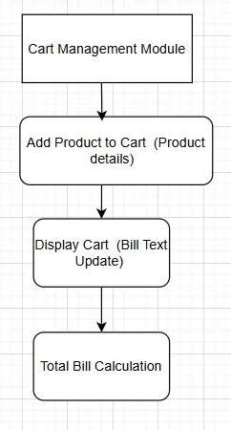
List of modules
Cart Management Module
Inputs: Product details (name, quantity, price, total, payment
method).
Actions: Adds products to cart, updates the bill text.
Output: Displays the updated cart and the total bill.

Slide 12
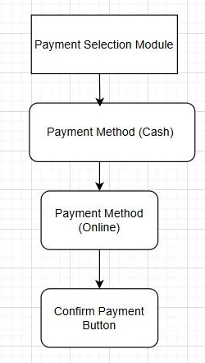
List of modules
Payment Selection Module
Inputs: Payment method (Cash or Online).
Actions: Selects payment method and confirms the selection.
Output: Passes selected payment method to the cart.

Slide 13
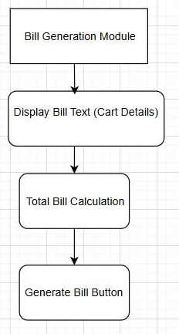
List of modules
Bill Generation Module
Inputs: Cart details (products, quantities, prices, payment
method).
Actions: Calculates total bill, updates text display.
Output: Displays the generated bill with itemized details and
total amount.

Slide 14
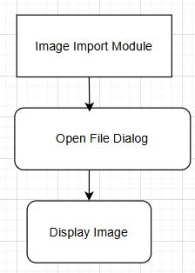
List of modules
Image Import Module
Inputs: Image file (via file dialog).
Actions: Opens file dialog to select an image, processes and
displays the image.
Output: Displays the selected image.

Slide 15
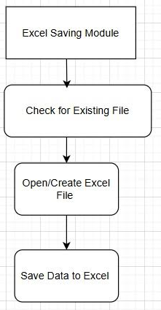
List of modules
Excel Saving Module
Inputs: Customer and cart details.
Actions: Checks for the existence of the file, creates a new file
if needed, saves the data.
Output: Data is saved to an Excel file (customer_details.xlsx).

Slide 16
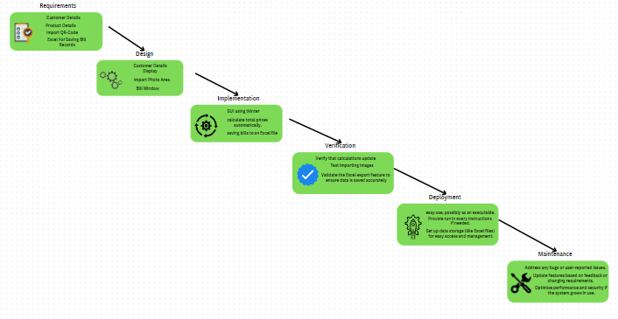

Waterfall Model

Slide 17
Software Testing
Functional Testing
Purpose: To ensure that all features work as expected according to the specifications.
Scope: This includes testing each function:
Importing and displaying an image.
Calculating the total price based on quantity and price.
Selecting the payment method.
Adding products to the cart and generating bill text.
Saving customer details to an Excel sheet.
Clearing fields and the bill text area.

Slide 18
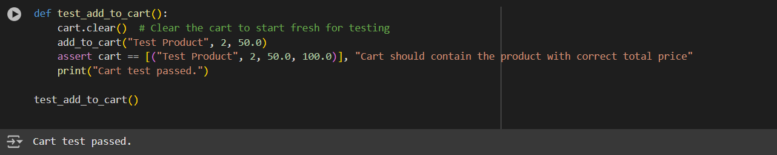
Software Testing
Cart Operations

Slide 19
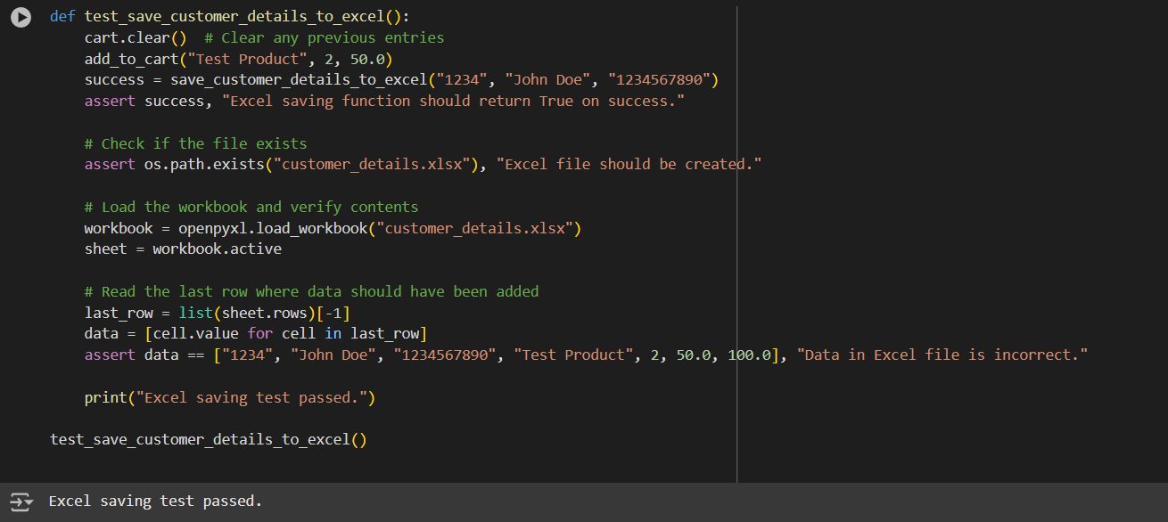
Software Testing
Excel Saving Functionality

Slide 20
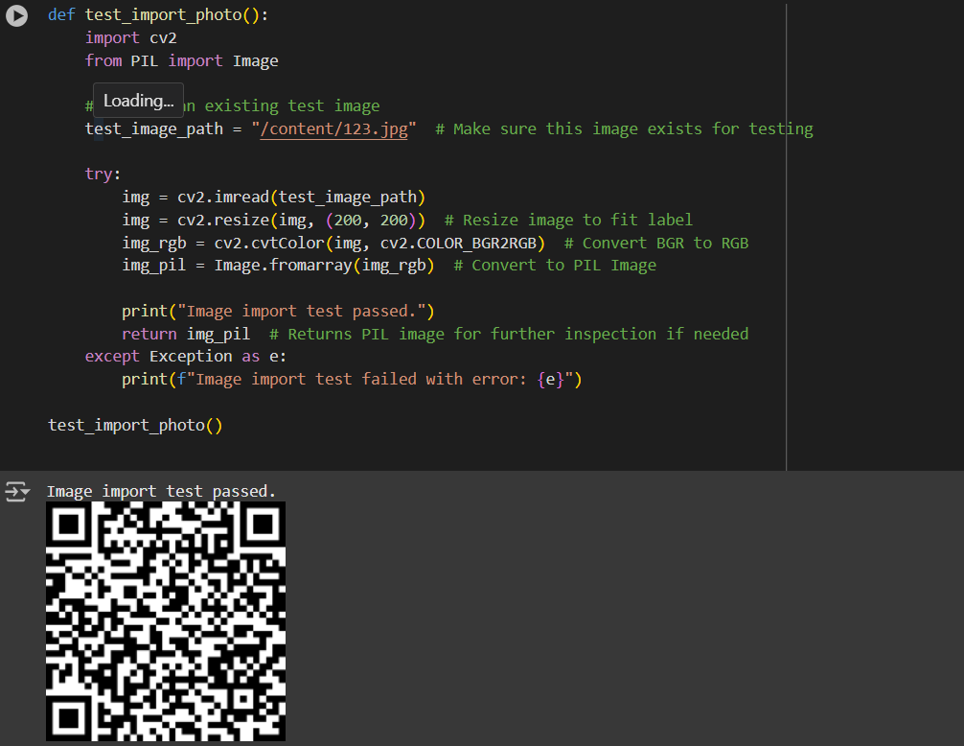
Software Testing
Image Import Functionality

Slide 21
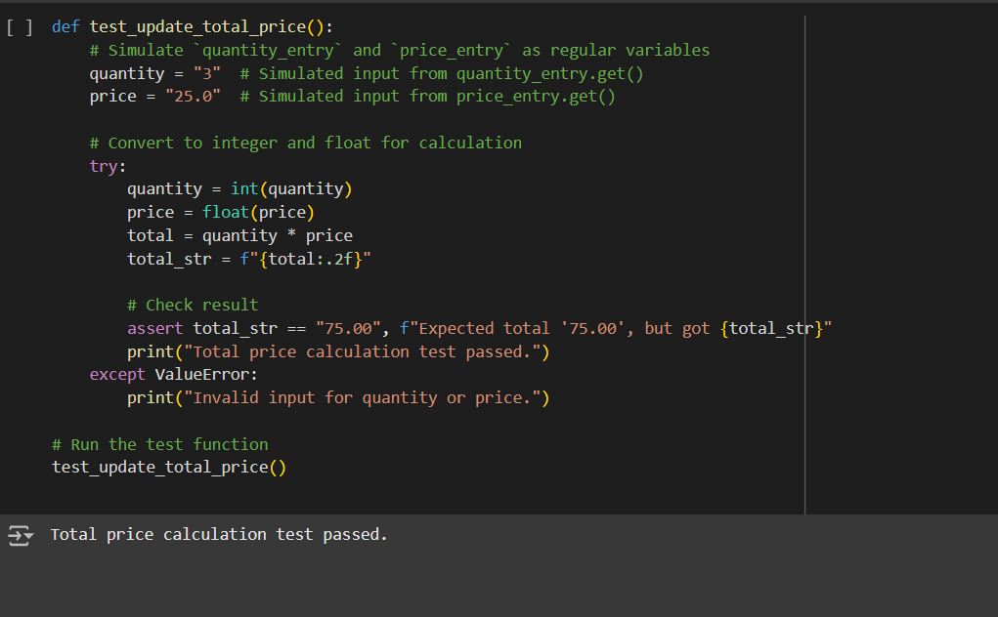
Software Testing
Total Price Calculation

Slide 22
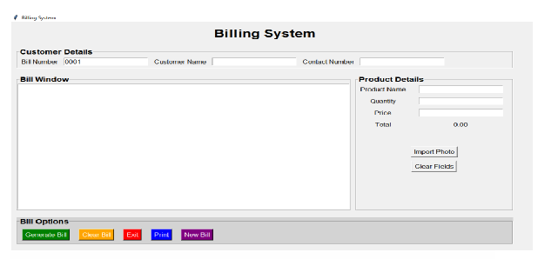
Output
User-Interface

Slide 23
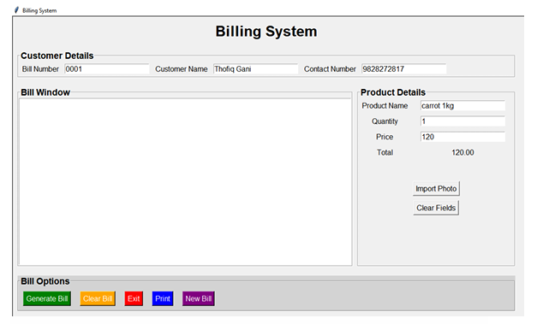
Output
Details are Filled by User

Slide 24
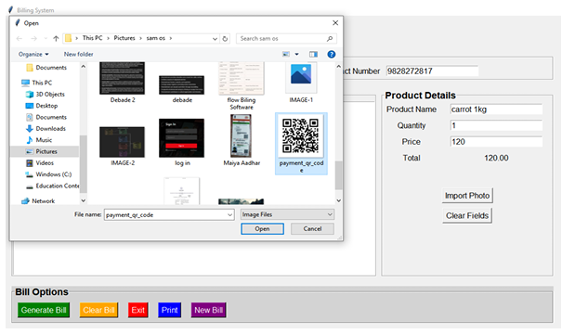
Output
QR-Code import from Computer

Slide 25
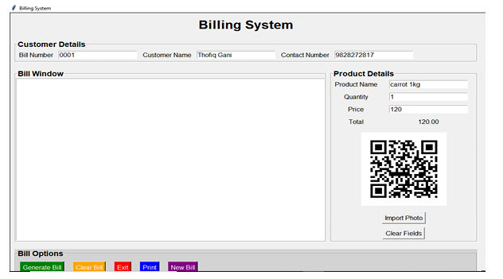
Output
QR-Code imported from Computer

Slide 26
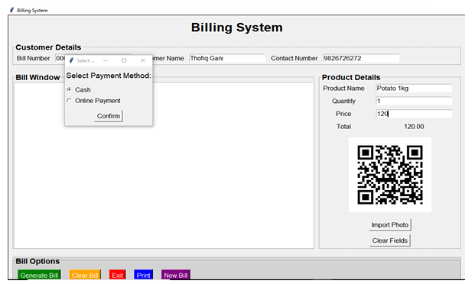
Output
Payment Option asked for User

Slide 27
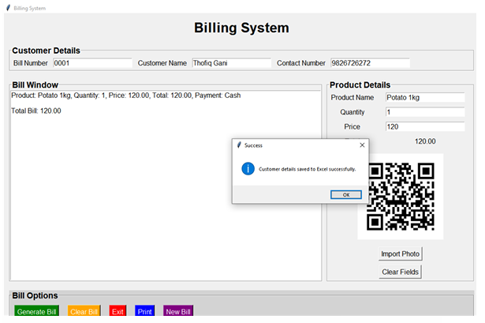
Output
All the details are Stored in Excel

Slide 28
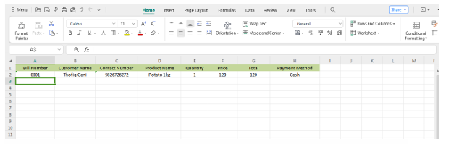
Output
Stored Details are Displayed in Excel file

Slide 29
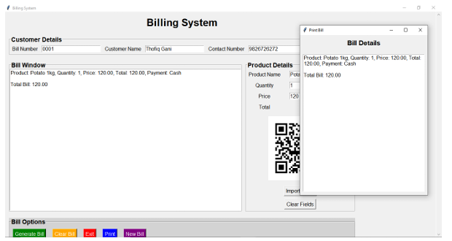
Output
Print the bill using Print Button

Slide 30
Conclusion
The QR code billing system significantly improves transaction management and customer interactions. By automating billing and enabling secure online payments, it enhances customer experience and operational efficiency. The system facilitates accurate tracking of purchase data and supports multiple payment methods, catering to diverse preferences. Overall, this project effectively addresses the limitations of traditional billing, positioning businesses for success in a digital marketplace.
Department of Artificial Intelligence and Data Science

Slide 31
References
H. Smith and K. Johnson, "A Comparative Study of QR Code Payment Systems and Their Security Implications," International Journal of Computer Applications, vol. 145, no. 9, pp. 24-29, June 2020.
S. Gupta and M. Sharma, "Excel as a Data Management Tool in Small Enterprises: Advantages and Limitations," Journal of Data Science and Business Intelligence, vol. 8, no. 2, pp. 132-139, May 2021.
A. Brown, J. Thompson, and L. Williams, "An Overview of Billing System Software Architecture Using Python and GUI Frameworks," in Proceedings of the 2022 IEEE Conference on Software Engineering Practice, San Francisco, CA, USA, 2022, pp. 450-456.
T. Lee and R. Kumar, "Integrating QR Code Payments for Improved Retail Experience," J ournal of Modern Payment Systems, vol. 12, no. 4, pp. 289-298, Aug. 2023.

Slide 32
Thank You

